Slide 1
LECTURE # 26
PROOF BY CONTRADICTION
  A proof by contradiction is based on the fact that either a statement is true or it is false but not both. Hence the supposition, that the statement to be proved is false, leads logically to a contradiction, impossibility or absurdity, then the supposition must be false. Accordingly, the given statement must be true.
  This method of proof is also known as reductio ad absurdum because it relies on reducing a given assumption to an absurdity.

Slide 2
  Many theorems in mathematics are conditional statements (p→q). Now the negation of the implication p→q is: ~(p→q) ≡ ~(~p∨ q)
  ≡ ~(~p) ∧ (~q) ≡ p ∧ ~q
  Clearly if the implication is true, then its negation must be false, i.e., leads to a contradiction.
  Hence p→q ≡ (p ∧ ~q) →c
  where c is a contradiction.
  Thus to prove an implication p→q by contradiction method we suppose that (p ∧ ~q) is true and ultimately arrive at a contradiction.

Slide 3
  The method of proof by contradiction, may be summarized as follows:
  1. Suppose the statement to be proved is false.
  2. Show that this supposition leads logically to a contradiction.
  3. Conclude that the statement to be proved is true.

Slide 4
THEOREM
  There is no greatest integer.
  PROOF
  Suppose there is a greatest integer N. Then n ≤ N for every integer n.
  Let M = N + 1
  Now M is an integer since it is a sum of integers.
  Also M > N since M = N + 1
  Thus M is an integer that is greater than the greatest integer, which is a contradiction. Hence our supposition is not true and so there is no greatest integer.

Slide 5
EXERCISE
  Give a proof by contradiction for the statement:
  “If n² is an even integer then n is an even integer.”
  PROOF
  (First we assume that the given implication is false i.e. n² is an even integer (i.e. T) and n is not even (i.e. F)).
  Suppose n² is an even integer and n is not even, so that n is odd.

Slide 6
  Hence n = 2k + 1 for some integer k.
  Now n² = (2k + 1)²
  n² = 4k² + 4k + 1
  n² = 2·(2k² + 2k) + 1
  n² = 2r + 1
  where r = (2k² + 2k) ∈Z
  This shows that n² is odd, which is a contradiction to our supposition that n² is even. Hence the given statement is true.

Slide 7
EXERCISE
  Prove that if n is an integer and n³ + 5 is odd, then n is even using contradiction method.
  SOLUTION
  Suppose that n³ + 5 is odd and n is not even (odd). Since n is odd and the product of two odd numbers is odd, it follows that n² is odd and n³ = n². n is odd. Further, since the difference of two odd numbers is even, it follows that
  (n³ + 5) - n³ =5
  is odd. But this is a contradiction. Therefore, the supposition that n³ + 5 and n are both odd is wrong and so the given statement is true.

Slide 8
EXERCISE
  Prove by contradiction method, the statement:If n and m are odd integers, then n + m is an even integer.
  SOLUTION
  Suppose n and m are odd and n + m is not even (odd).
  Now n = 2p + 1 for some integer p
  and m = 2q + 1 for some integer q
  Hence n + m = (2p + 1) + (2q + 1)
  = 2p + 2q + 2 = 2· (p + q + 1)
  which is even, contradicting the assumption that n + m is odd.

Slide 9
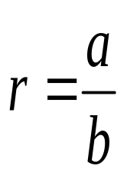
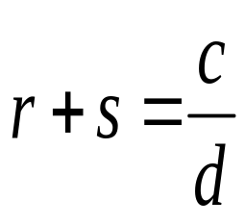
THEOREM
  The sum of any rational number and any irrational number is irrational.
  PROOF
  We suppose that the negation of the statement is true. That is, we suppose that there is a rational number r and an irrational number s such that r + s is rational.
  By definition of rational
……………(1)
and
……………(2)
  for some integers a, b, c and d with b≠ 0 and d ≠ 0.

Slide 10
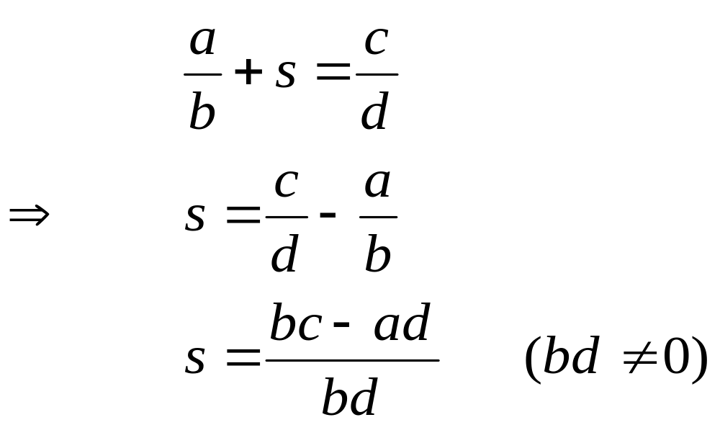
  Using (1) in (2), we get
  Now bc - ad and bd are both integers, since products and difference of integers are integers. Hence s is a quotient of two integers bc-ad and bd with bd ≠ 0. So by definition of rational, s is rational.
  This contradicts the supposition that s is irrational. Hence the supposition is false and the theorem is true.

Slide 11

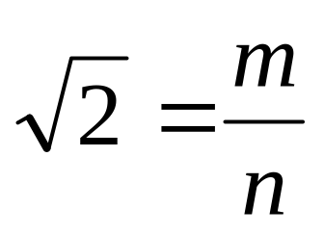
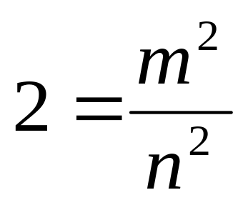
EXERCISE
  Prove that is irrational.
  PROOF
  Suppose is rational. Then there are integers m and n with no common factors so that
  Squaring both sides gives
  Or m² = 2n²………(1)
  This implies that m² is even (by definition of even). It follows that m is even. Hence
  m = 2 k for some integer k …(2)

Slide 12
  Substituting (2) in (1), we get
  (2k)² = 2n²
  ⇒ 4k² = 2n²
  ⇒ n² = 2k²
  This implies that n² is even, and so n is even. But we also know that m is even. Hence both m and n have a common factor 2. But this contradicts the supposition that m and n have no common factors. Hence our supposition is false and so the theorem is true.

Slide 13
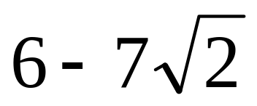
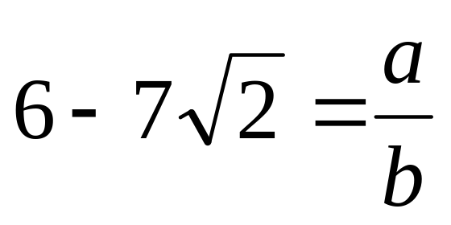
EXERCISE
  Prove by contradiction that is irrational.
  PROOF
  First we assume our statement to be false. Suppose is rational.
  Then by definition of rational,
  for some integers a and b with b ≠ 0.
  Now consider,

Slide 14
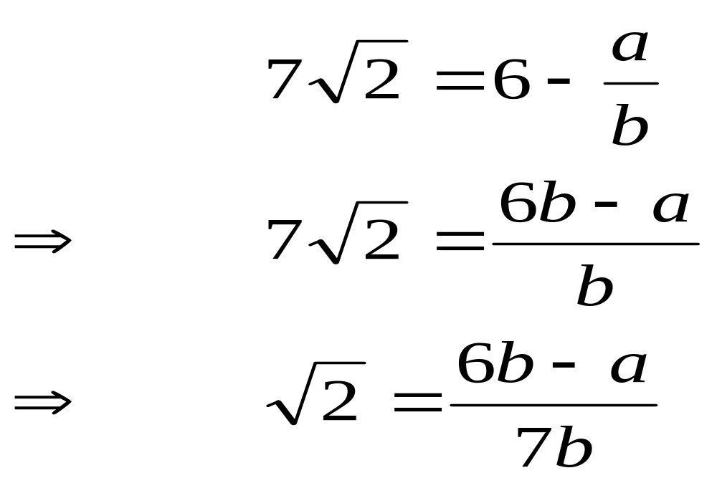

  Since a and b are integers, so are
  6b - a and 7b with 7b ≠ 0;
  hence is a quotient of the two integers 6b - a and 7b with 7b ≠ 0.
  Accordingly, is rational (by definition of rational).
  This contradicts the fact that is irrational.
  Hence our supposition is false and so is irrational.

Slide 15
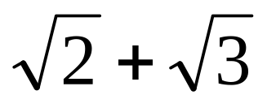
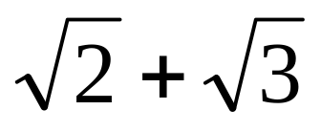
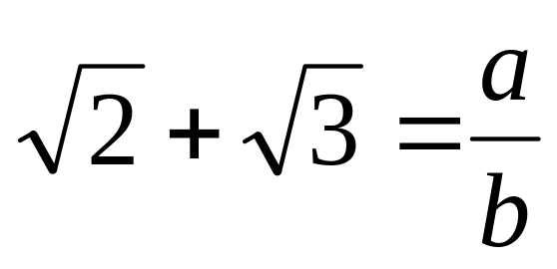
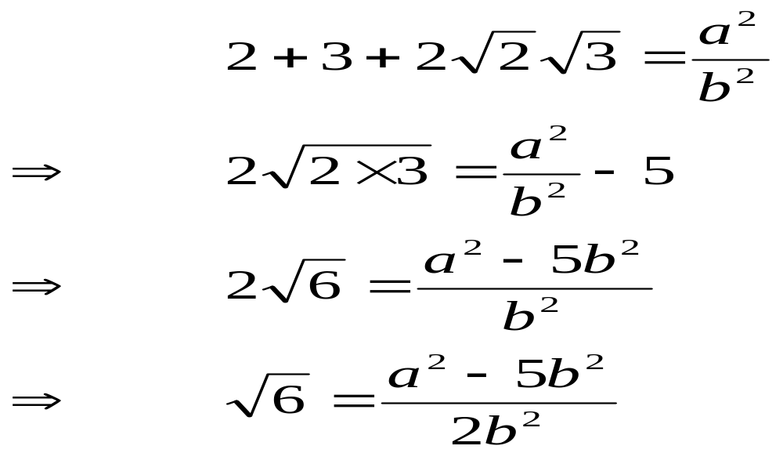
EXERCISE
  Prove that is irrational.
  SOLUTION
  Suppose is rational. Then, by definition of rational, there exists integers a and b with b≠0 such that
  Squaring both sides, we get

Slide 16
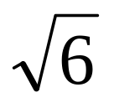

  Since a and b are integers,
  so are a² - 5b² and 2b² with 2b²≠0. Hence is the quotient of two integers a² - 5b² and 2b² with 2b²≠0. Accordingly, is rational. But this is a contradiction, since is not rational. Hence our supposition is false and so
  is irrational.

Slide 17
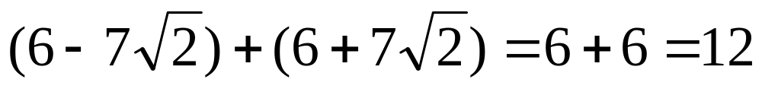
REMARK
  The sum of two irrational numbers need not be irrational in general
  which is rational.

Slide 18
EXERCISE
  Prove that for any integer a and any prime number p, if p|a, then
  p | (a + 1).
  PROOF
  Suppose there exists an integer a and a prime number p such that p|a and p|(a+1).
  Then by definition of divisibility there exist integer r and s so that
  a = p·r and a + 1 = p·s
  It follows that
  1 = (a + 1) - a
  1 = p·s - p·r

Slide 19
  1 = p·s - p·r
  1 = p·(s-r) where s - r ∈Z
  This implies p|1.
  But the only integer divisors of 1 are 1 and -1 and since p is prime p>1. This is a contradiction.
  Hence the supposition is false, and the given statement is true.

Slide 20
PROOF BY CONTRAPOSITION
  A proof by contraposition is based on the logical equivalence between a statement and its contrapositive. Therefore, the implication p → q can be proved by showing that its contrapositive ~ q → ~ p is true. The contrapositive is usually proved directly.
  The method of proof by contrapositive may be summarized as:
  1. Express the statement in the form if p then q.
  2. Rewrite this statement in the contrapositive form ~ q → ~ p
  3. Prove the contrapositive by a direct proof.

Slide 21
EXERCISE
  Prove that for all integers n, if n² is even then n is even.
  PROOF
  The contra positive of the given statement is:
  “if n is not even (odd) then n² is not even (odd)”
  We prove this contrapositive statement directly.
  Suppose n is odd. Then n = 2k + 1 for some k ∈ Z
  Now n² = (2k+1)²
  = 4k² + 4k + 1

Slide 22
  n² = 4k² + 4k + 1
  n² = 2·(2k² + 2k) + 1
  n² = 2·r + 1
  where r = 2k² + 2k ∈Z
  Hence n² is odd. Thus the contrapositive statement is true and so the given statement is true.

Slide 23
EXERCISE
  Prove that if 3n + 2 is odd, then n is odd.
  PROOF
  The contrapositive of the given conditional statement is
  “ if n is even then 3n + 2 is even”
  Suppose n is even, then
  n = 2k for some k ∈Z
  Now 3n + 2= 3 (2k) + 2
  = 2. (3k + 1)
  = 2.r where r = (3k + 1) ∈ Z
  Hence 3n + 2 is even. We conclude that the given statement is true since its contrapositive is true.

Slide 24
EXERCISE
  Prove that if n is an integer and n³ + 5 is odd, then n is even.
  PROOF
  Suppose n is an odd integer. Since, a product of two odd integers is odd, therefore n² = n.n is odd; and n³ = n².n is odd.
  Since a sum of two odd integers is even therefore n³ + 5 is even.
  Thus we have proven that
  if n is odd then n³ + 5 is even
  Since this is the contrapositive of the given conditional statement, so the given statement is true.

Slide 25
EXERCISE
  Prove that if n² is not divisible by 25, then n is not divisible by 5.
  SOLUTION
  The contra positive statement is:
  “if n is divisible by 5, then n² is divisible by 25”
  Suppose n is divisible by 5. Then by definition of divisibility
  n = 5·k for some integer k
  Squaring both sides
  n² = 25·k² where k² ∈Z
  ⇒ n² is divisible by 25.

Slide 26
EXERCISE
  Prove the statement by contraposition:
  For all integers m and n, if m + n is even then m and n are both even or m and n are both odd.
  PROOF
  The contrapositive statement is:
  “For all integers m and n, if m and n are not both even and m and n are not both odd, then m + n is not even.
  Or more simply,
  “For all integers m and n, if one of m and n is even and the other is odd, then m + n is odd”

Slide 27
  Suppose m is even and n is odd. Then
  m = 2p for some integer p
  and n = 2q + 1 for some integer q
  Now m + n = (2p) + (2q + 1)
  = 2·(p+q) + 1
  = 2·r + 1 where r = p+q is an integer
  Hence m + n is odd.
  Similarly, taking m as odd and n even, we again arrive at the result that m + n is odd.
  Thus, the contrapositive statement is true. So the given implication is true.

